Slide 1
DOS and BIOS Interrupts
DOS and BIOS interrupts are used to perform some very useful functions, such as displaying data to the monitor, reading data from keyboard, etc.
They are used by identifying the interrupt option type, which is the value stored in register AH and providing, whatever extra information that the specific option requires.

Slide 2
BIOS Interrupt 10H
Option 0H – Sets video mode.
Registers used:
  AH = 0H
  AL = Video Mode.
    3H - CGA Color text of 80X25
    7H - Monochrome text of 80X25
Ex:
  MOV AH,0
  MOV AL,7
  INT 10H

Slide 3
BIOS Interrupt 10H
Option 2H – Sets the cursor to a specific location.
Registers used:
  AH = 2H
  BH = 0H selects Page 0.
  DH = Row position.
  DL = Column position.

Slide 4
BIOS Interrupt 10H
Ex:
  MOV AH,2
  MOV BH,0
  MOV DH,12
  MOV DL,39
  INT 10H

Slide 5
BIOS Interrupt 10H
Option 6H – Scroll window up. This interrupt is also used to clear the screen when you set AL = 0.
Registers used:
  AH = 6H
  AL = number of lines to scroll.
  BH = display attribute.
  CH = y coordinate of top left.
  CL = x coordinate of top left.
  DH = y coordinate of lower right.
  DL = x coordinate of lower right.

Slide 6
BIOS Interrupt 10H
Clear Screen Example:
  MOV AH,6
  MOV AL,0
  MOV BH,7
  MOV CH,0
  MOV CL,0
  MOV DH,24
  MOV DL,79
  INT 10H
The code above may be shortened by using AX, BX and DX registers to move word size data instead of byte size data.

Slide 7
BIOS Interrupt 10H
Option 7H – Scroll window down. This interrupt is also used to clear the screen when you set AL = 0.
Registers used:
  AH = 7H
  AL = number of lines to scroll.
  BH = display attribute.
  CH = y coordinate of top left.
  CL = x coordinate of top left.
  DH = y coordinate of lower right.
  DL = x coordinate of lower right.

Slide 8
BIOS Interrupt 10H
Option 8H – Read a character and its attribute at the cursor position.
Registers used:
  AH = 8H and returned attribute value.
  AL = Returned ASCII value.
  BH = display page.

Slide 9
BIOS Interrupt 10H
Option 9H – Write a character and its attribute at the cursor position.
Registers used:
  AH = 9H.
  AL = ASCII value.
  BH = display page.
  BL = attribute.
  CX = number of characters to write.

Slide 10
Attribute Definition
Monochrome display attributes
  Blinking
    D7 = 0 - Non-blinking
    D7 = 1 - Blinking
  Intensity
    D3=0 - Normal intensity
    D3=1 - Highlighted intensity
  Background and foreground
    D6 D5 D4 and D2 D1 D0
      White = 0 0 0
      Black = 1 1 1

Slide 11
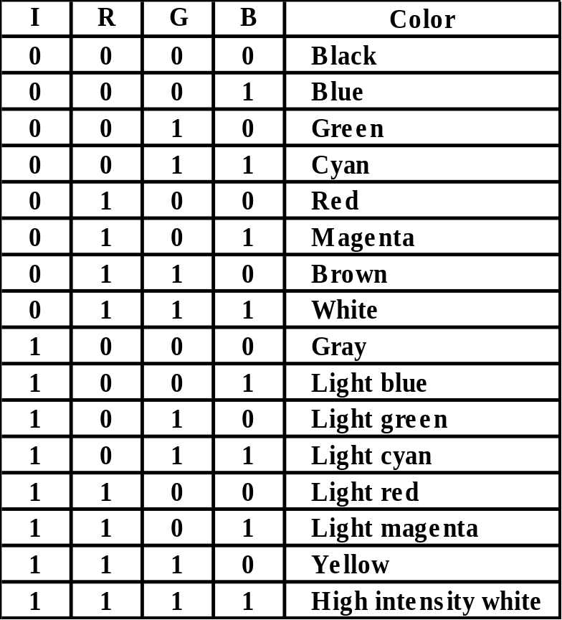
Attribute Definition
Color display attributes
  Blinking
    D7 = 0 - Non-blinking
    D7 = 1 - Blinking
  Intensity
    D3=0 - Normal intensity
    D3=1 - Highlighted intensity
  Background and foreground
    D6 D5 D4 and D2 D1 D0
      RGB values defined by the table to the right.

Slide 12
DOS Interrupt 21H
Option 1 – Inputs a single character from keyboard and echoes it to the monitor.
Registers used:
  AH = 1
  AL = the character inputted from keyboard.
Ex:
  MOV AH,1
  INT 21H

Slide 13
DOS Interrupt 21H
Option 2 – Outputs a single character to the monitor.
Registers used:
  AH = 2
  DL = the character to be displayed.
Ex:
  MOV AH,2
  MOV DL,’A’
  INT 21H

Slide 14
DOS Interrupt 21H
Option 9 – Outputs a string of data, terminated by a $ to the monitor.
Registers used:
  AH = 9
  DX = the offset address of the data to be displayed.
Ex:
  MOV AH,09
  MOV DX,OFFSET MESS1
  INT 21H

Slide 15
DOS Interrupt 21H
Option 0AH – Inputs a string of data from the keyboard.
Registers used:
  AH = 9
  DX = the offset address of the location where string will be stored.
DOS requires that a buffer be defined in the data segment. It should be defined as follows:
  1st byte contains the size of the buffer.
  2nd byte is used by DOS to store the number of bytes stored.

Slide 16
DOS Interrupt 21H
Ex:
  .DATA
  BUFFER1 DB 15,?,15 DUP (FF)
  .
  .
  MOV AH,0AH
  MOV DX,OFFSET BUFFER1
  INT 21H
Assume “Go Tigers!” was entered on the keyboard.
  BUFFER1 = 10,10,’Go Tigers!’,CR,255,255,255,255

Slide 17
DOS Interrupt 21H
Option 4CH – Terminates a process, by returning control to a parent process or to DOS.
Registers used:
  AH = 4CH
  AL = binary return code.
Ex:
  MOV AH,4CH
  INT 21H

